Slide 1
CS 2212
Introduction to Software Engineering
Chapter 11 Component Level Design

Slide 2
Copyright Notice This Presentation and Its Associated Video Contain Copyright Material. This Presentation and Its Associated Video Are Provided for Teaching Purposes of CS2212 and Should Not Be Posted In Any External Site, Or Shared with. This Presentation and Its Associated Video Are Provided For Instructional Personal Use Only, and Only For The Purposes of the CS2212 Course.

Slide 3
Part 31
Component Based Software Engineering (CBSE)
Prolific programmers contribute to certain disaster.
― Niklaus Wirthe.
Notes:
This lesson introduces the basic steps in a software engineering project at a high level.
In practice, steps often overlap.

Slide 4
Learning Objectives in this Part
To understand the concept of Component Based Development

Slide 5
Component-Based Development
Component-based software engineering (CBSE) is a process that emphasizes the design and construction of computer-based systems using reusable software components
When considering reuse in a project, the software team asks:
Are commercial off-the-shelf (COTS) components available to implement the requirements of the software?
Are internally-developed reusable components available to implement the requirements?
Are the interfaces for available components compatible within the architecture of the system being built?

Slide 6
Component-Based Development
There are some impediments to reuse that make it more difficult to do in practice, however:
Few companies and organizations have anything that even slightly resembles a comprehensive software reusability plan
Although an increasing number of software vendors currently sell tools or components that provide direct assistance for software reuse, the majority of software developers do not use them
Relatively little training is available to help software engineers and managers understand and apply reuse

Slide 7
Component-Based Development
There are some impediments to reuse that make it more difficult to do in practice, however:
Many software practitioners continue to believe that reuse is “more trouble than it’s worth”
Many companies continue to encourage software development methodologies which do not facilitate reuse
Few companies provide incentives to produce reusable program components

Slide 8
Domain Engineering
A key aspect of CBSE is domain engineering
The intent of domain engineering is to identify, construct, catalog, and disseminate a set of software components that have applicability to existing and future software in a particular application domain
Domain engineering entails analysis, construction, and ultimately dissemination to share components and facilitate reuse

Slide 9
Domain Engineering
Domain analysis typically follows this process:
Define the domain to be investigated
Categorize the items extracted from the domain
Collect a representative sample of applications in the domain
Analyze each application in the sample and define analysis classes
Develop requirements model for the classes
With this information, construction of the reusable components can commence and, upon completion, dissemination can occur

Slide 10
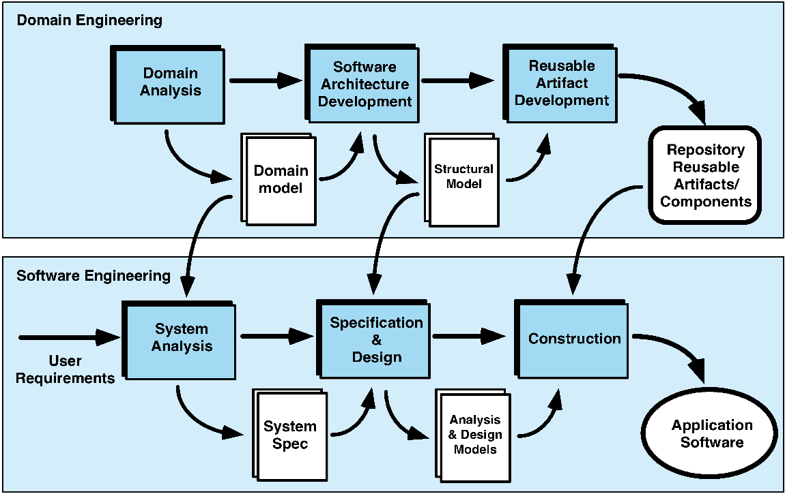
The CBSE Process

Slide 11
Identifying Reusable Components
Is component functionality required in future implementations?
How common is the component's function within the domain?
Is there duplication of the component's function within the domain?
Is the component hardware-dependent?
Does the hardware remain unchanged between implementations?
Can the hardware specifics be removed to another component?
Is the design optimized enough for the next implementation?

Slide 12
Identifying Reusable Components
Can we parameterize a non-reusable component so that it becomes reusable?
Is the component reusable in many implementations with only minor changes?
Is reuse through modification feasible?
Can a non-reusable component be decomposed to yield reusable components?
How valid is component decomposition for reuse?

Slide 13
CBSE Activities
Unfortunately, the existence of reusable components does not guarantee that these components can be integrated easily or effectively into the architecture chosen for a new application
Consequently, a sequence of component based activities is applied when a component is proposed for use:
Component qualification
Component adaptation
Component composition

Slide 14
Component Qualification
Component qualification ensures that a candidate component will perform the function required, will fit into the architectural style, and will exhibit appropriate quality characteristics for the application
An interface specification for a component provides valuable information about the operation and use of a component
That said, an interface specification alone does not provide all the information required to determine if a proposed component can be used effectively, and so more work is required …

Slide 15
Component Qualification
Before a component can be used, you must consider:
Application programming interface (API)
Development and integration tools required by the component
Run-time requirements including resource usage (e.g., memory or storage), timing or speed, and network protocol
Service requirements including operating system interfaces and support from other components
Security features including access controls and authentication protocol
Embedded design assumptions including the use of specific algorithms
Exception handling

Slide 16
Component Adaptation
To achieve easy integration of a component, it is necessary that:
Consistent methods of resource management have been implemented for all components in the library
Common activities such as data management exist for all components
Interfaces within the architecture and with the external environment have been implemented in a consistent manner
In reality, even after a component has been qualified for use, some degree of adaptation is necessary to overcome conflicts and other issues to make it work

Slide 17
Component Composition
The component composition activity assembles qualified, adapted, and engineered components to populate the architecture established for an application
An infrastructure must be established to bind components together
Architectural ingredients for composition include:
Data exchange model
Automation
Structured storage
Underlying object model

Slide 18
Part 32
Frameworks Supporting Distributed Components
The best way to get a project done faster is to start sooner
― Jim Highsmith.
Notes:
This lesson introduces the basic steps in a software engineering project at a high level.
In practice, steps often overlap.

Slide 19
Learning Objectives in this Part
To see examples of Component Based Software Engineering (CBSE) Frameworks

Slide 20
Component-Based Software Engineering Frameworks
To support component-based software engineering, a library of components must be available to the software team
These components should have a consistent structure
A number of standards have been proposed over the years:
Remote Method Invocation (RMI)
Object Management Group CORBA
Microsoft COM/DCOM and .NET
Sun JavaBeans

Slide 21
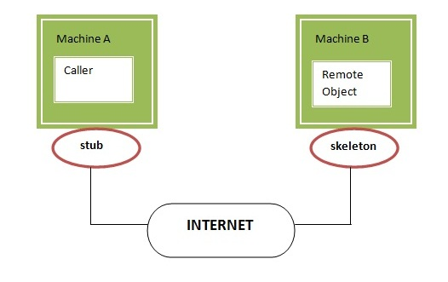
Remote Method Invocation (RMI)
The RMI (Remote Method Invocation) is an API that provides a mechanism to create distributed application in java. The RMI allows an object to invoke methods on an object running in another JVM.
https://www.javatpoint.com/RMI

Slide 22
RMI
Communication
modules
Proxy for A
A’s client stubs
A’s skeleton
A server stubs
dispatcher
X
A
ROID
modules
X is a “fake” object in the client side and is used in place of a “real” object
A in the server side. Communication and correspondence is achieved by the
“intermediate stud and skeleton objects offered by the RMI framework.

Slide 23
CORBA
An object request broker (ORB) provides services that enable reusable components (objects) to communicate with other components, regardless of their location within a system
Integration of CORBA components (without modification) within a system is assured if an interface definition language (IDL) interface is created for every component
Objects within the client application request one or more services from the ORB server; requests are made via an IDL or dynamically at run time
An interface repository contains all necessary information about the service’s request and response formats

Slide 24
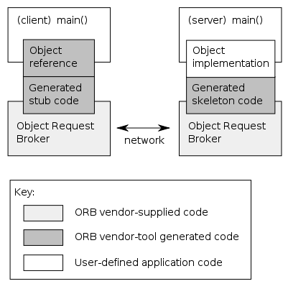
CORBA Schematic

Slide 25
Microsoft COM/DCOM and .NET
The Component Object Model (COM) provides a specification for using software components produced by various vendors within a single application running under the Windows operating system
First introduced in 1993, it became a foundation for a number of other Microsoft technologies in use today
This includes DCOM, a distributed version of COM that connected components on networked computers, and the .NET framework

Slide 26
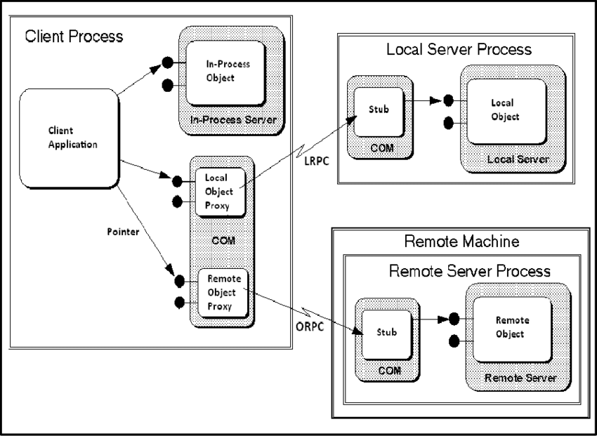
Microsoft DCOM Schematic

Slide 27
Sun JavaBeans
JavaBeans is a software component model for Java, originally introduced in 1996, allowing developers to create and distribute Java components that can be composed together into applications by end users
This should not be confused with the similarly named Enterprise JavaBeans, which are components in a Java EE application server to provide encapsulated business logic for enterprise applications
"Java Beans" are used to store the data retrieved data from the database and used as a container to carry the data between the Servlets and JSPs in MVC model. A class (container) with setters and getters is used to (put) and (get) the data.
"Enterprise Java Beans" are similar to "Java Beans" with added features such as Session Management, Security, Transaction etc with the aid of different types of EJBs that are a) Session Bean; b) Entity Bean; c) Message Driven Beans

Slide 28
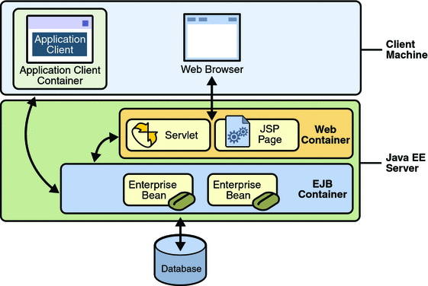
Java Enterprise Java Beans

Slide 29
Retrospect on Component-Based Software Engineering Frameworks
None of the standards (CORBA, COM, or JavaBeans) have come to dominate the industry
While they have influenced the development of other frameworks and technologies, they are not themselves widely used today
The rise of web technologies and web services have, for the most part, supplanted these as the way of connecting software components together

Slide 30
Your Turn
What is Domain Engineering?
Why component reuse is important? List four challenges in designing and using re-usable components.
What were the benefits of Component Based Software Engineering (CBSE)?
What are some of the drawbacks of CBSE?
Check-out the content of the following sites:
https://en.wikipedia.org/wiki/Component-based_software_engineering
https://www.geeksforgeeks.org/component-based-software-engineering/
https://www.techopedia.com/definition/31002/component-based-development-cbd

